Slide 1
Lecture 18: Classes – Part I
Class page: https://github.com/tsung-wei-huang/cs1410-40
Dr. Tsung-Wei Huang
Department of Electrical and Computer Engineering
University of Utah, Salt Lake City, UT
Notes:
Morning everyone
Today we are looking into control flow in C++.

Slide 2
Introduction
You’ll begin writing programs that employ the basic concepts of object-oriented programming.
Typically, programs consist of function main and one or more classes, each containing data members and member functions.
In this chapter, we develop a simple, well-engineered framework for organizing object-oriented programs.

Slide 3
Example
Let’s begin with a simple analogy to help you understand what C++ “class” is
Suppose you want to drive a car and make it go faster by pressing down on its accelerator pedal.
What must happen before you can do this? Well, before you can drive a car, someone has to design it and build it.
In a sense, the pedal “hides” the complex mechanisms that actually make the car go faster.
People with little or no knowledge of how cars are engineered can drive a car easily, simply by using the user-friendly “interfaces” to the car’s complex internal mechanisms.
Accelerator pedal, brake pedal, steering wheel, transmission shifting …

Slide 4
Example
Unfortunately, you cannot drive the engineering drawings of a car—so before you can drive a car, it must be built from the engineering drawings that describe it.
A completed car will have an actual accelerator pedal to make the car go faster.
But even that’s not enough—the car will not accelerate on its own, so the driver must press the accelerator pedal to tell the car to go faster.
In C++ software engineering, we use “class” to represent the abstraction
Pedal => function; you don’t need to know how the function is implemented but what it is offering you

Slide 5
Classes, Objects, and Members
Now let’s use our car example to introduce the key object-oriented programming concepts of this section.
Performing a task in a program requires a function.
In C++, we create a program unit called a class to house a function
A function belonging to a class is called a member function.
class => car
The function describes the actually performed operations.
In a class, you provide one or more member functions that are designed to perform the class’s tasks.
The function hides from its user the complex tasks.
Just as the accelerator pedal of a car hides from the driver the complex mechanisms of making the car go faster.

Slide 6
Time Class
We begin with an example (next page) that consists of class Time (lines 8–19), which represents the time of day in 24-hour clock format, the class’s member functions (lines 23–50) and a main function (lines 52–79) that creates and manipulates a Time object.
Function main uses this object and its member functions to set and display the time in both 24-hour and 12-hour formats.

Slide 7
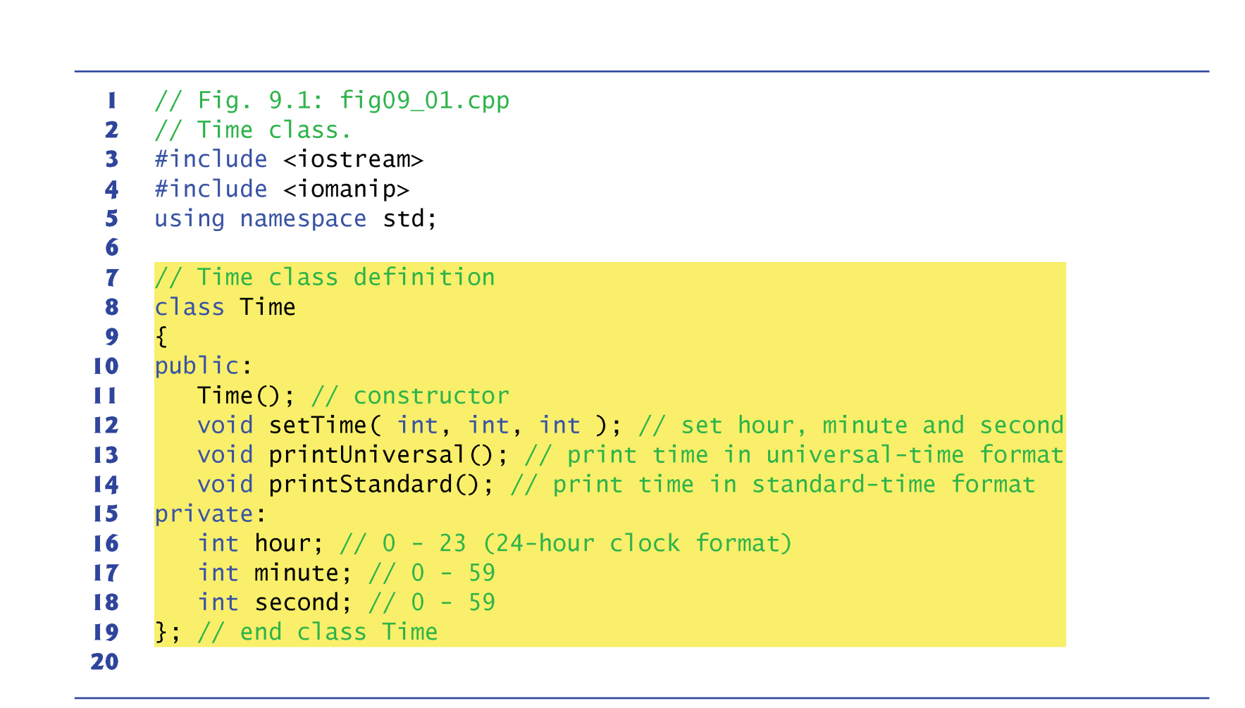
Time Class

Slide 8
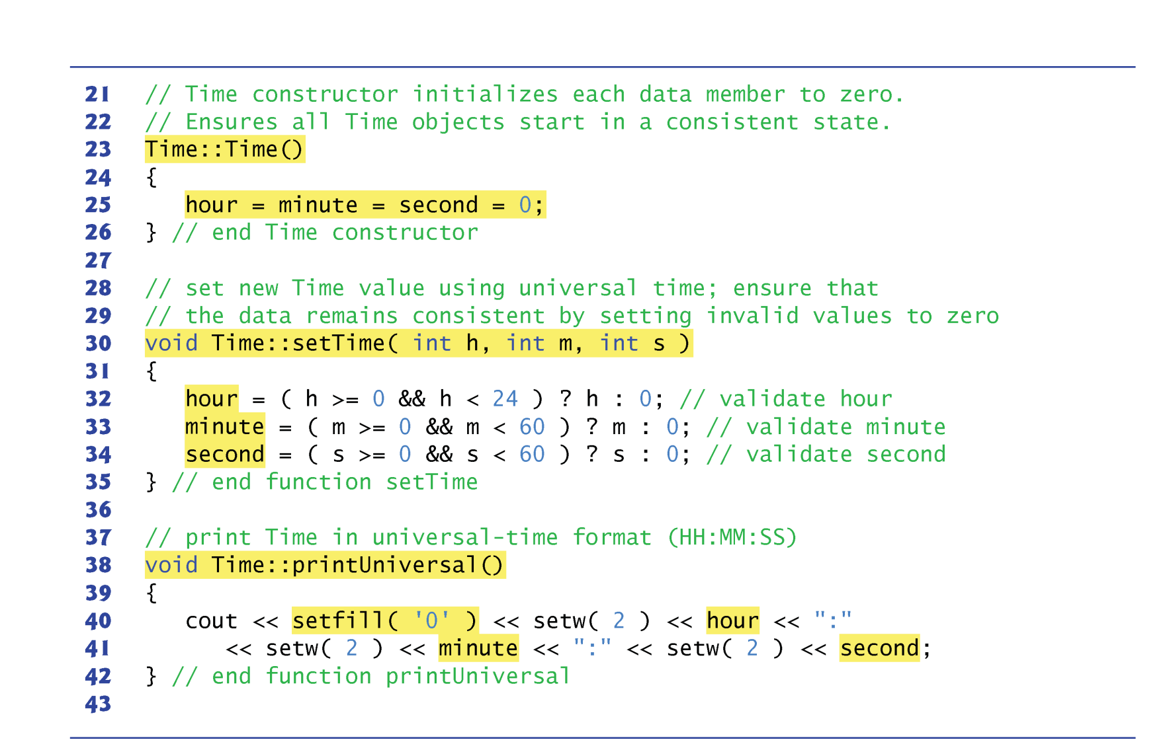
Time Class

Slide 9
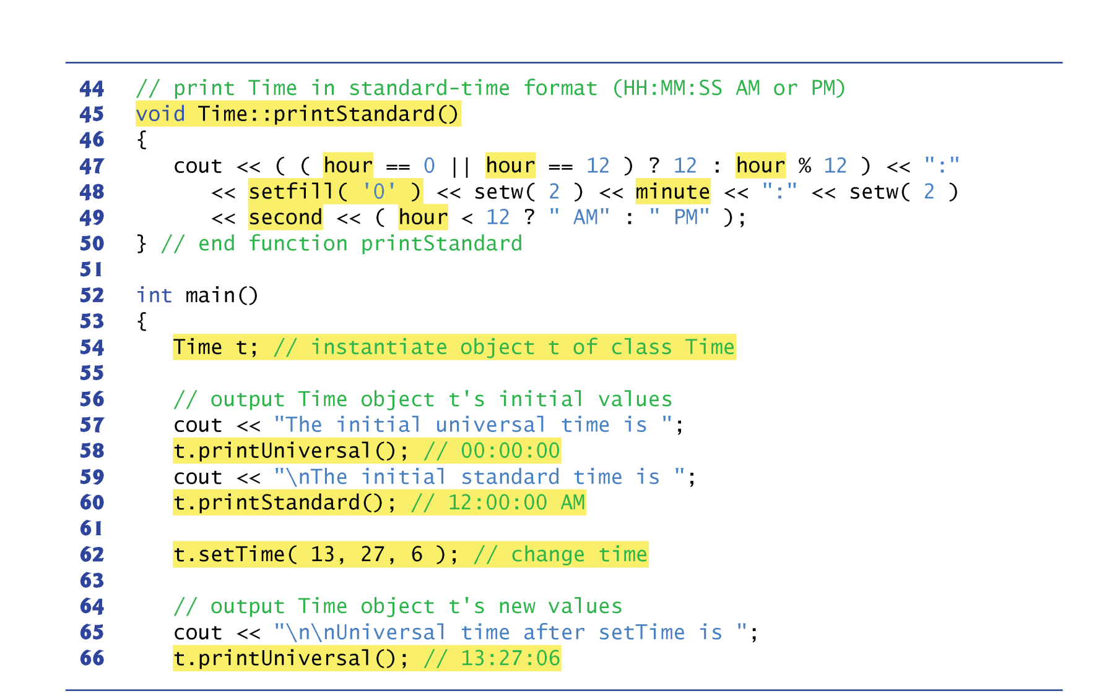
Time Class

Slide 10
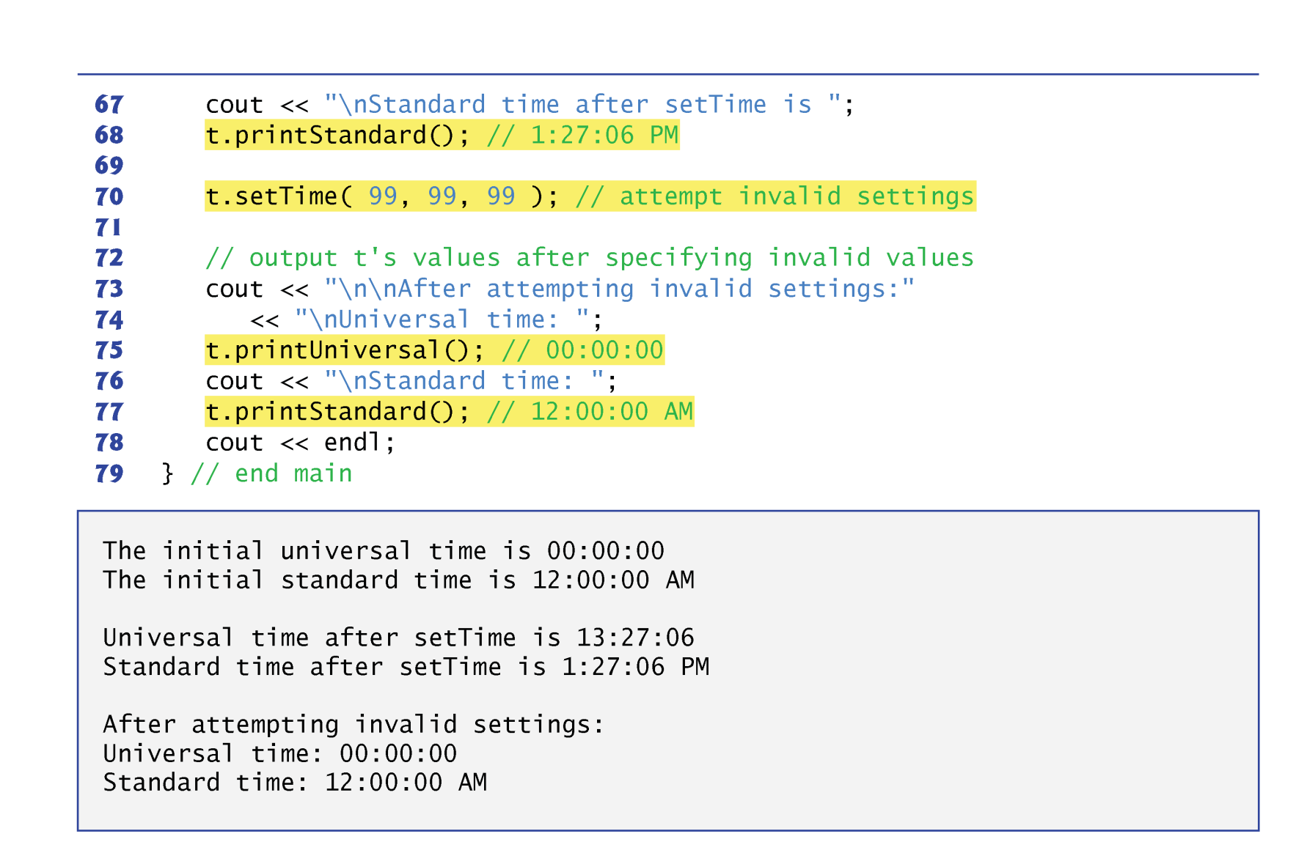
Time Class

Slide 11
Debrief: Time Class
Before creating a Time object, we must tell the compiler what member functions and data members belong to the class
A process known as defining the class.
The Time class definition (lines 8–19) begins with keyword class followed by the class name Time (line 8).
By convention, the name of a class begins with a capital letter
Each subsequent word in the class name begins with a capital letter.
This capitalization style is often referred to as camel case.
Every class’s body is enclosed in a pair of left and right braces ({ and }), as in lines 8 and 19.
The class definition terminates with a semicolon (line 19).

Slide 12
Debrief: Time Class
Line 10 contains the access-specifier label public:.
Access specifiers are always followed by a colon (:).
These functions appear after public: are the public member functions of the class
Also known as the interface of the class.
We provide four public member functions in class Time —Time, setTime, printUniversal and printStandard.
These services allow the client code to interact with an object of the class to manipulate the class’s data..
We’ll soon see that classes can have non-public member functions as well.

Slide 13
Debrief: Time Class
Lines 16–18 declare three integer members to represent the hour, minute and second, respectively.
These declarations appear after the access-specifier label private:.
Variables or functions declared after access specifier private (and before the next access specifier) are accessible only to member functions of the class for which they’re declared.
Cannot be accessed by functions outside the class (such as main).
Normally, data members are listed in the private portion of a class and member functions are listed in the public portion.
Declaring data members with access specifier private is known as data hiding.
It’s possible to have private member functions and public data, as we’ll see later.

Slide 14
Debrief: Time Class
The member function with the same name as the class is called a constructor.
This is a special member function that initializes the data members of a class object.
A class’s constructor is called when a program creates an object of that class.
If a class does not explicitly include a constructor, the compiler provides a default constructor
A constructor with no parameters and no actions.
It’s common to have several constructors for a class, enabling objects to be initialized several ways.
Constructors cannot specify a return type.

Slide 15
Debrief: Time Class
The Time constructor (lines 23–26) initializes the data members to 0—the universal-time equivalent of 12 AM.
Called when the Time object is created to ensure that the object begins in a consistent state.
Invalid values cannot be stored in the data members of a Time object, because all subsequent attempts by a client to modify the data members are scrutinized by function setTime.
It’s strongly recommended that these data members be initialized by the class’s constructor
Private data members cannot be initialized directly.
Data members can also be assigned values by Time’s other member functions.

Slide 16
Debrief: Time Class
Function setTime (lines 30–35) is a public function that declares three int parameters and uses them to set the time.
A conditional expression tests each argument to determine whether the value is in a specified range.
In class Time, invalid values are set to zero to ensure that the object’s data values are always kept in range.
Even if the provided arguments were incorrect.
A value passed to setTime is a correct value if it’s in the allowed range for the member it’s initializing.
Ex: any number in the range 0–23 would be a correct value for the hour.

Slide 17
Debrief: Time Class
Function printUniversal (lines 38–42) takes no arguments and outputs the time in universal-time format (e.g., 13:27:06).
Parameterized stream manipulator setfill specifies the fill character that appear to the left of the digits in the number.
If the number being output fills the specified field, the fill character will not be displayed.
Once the fill character is specified with setfill, it applies for all subsequent values (i.e., setfill is a “sticky” setting).
This is in contrast to setw, which applies only to the next value.
Function printStandard (lines 45–50) takes no arguments and outputs the date in standard-time format (e.g., 1:27:06 PM).
setfill('0') is used to format the minute and second as two digit values with leading zeros if necessary.

Slide 18
Debrief: Time Class
Each member-function name in the function headers (lines 23, 30, 38 and 45) is preceded by the class name and ::, which is known as the binary scope resolution operator.
This “ties” each member function to the Time class definition.
After “tied” to the class, it is still within that class’s scope.
Without “Time::” preceding each function name, these functions would not be recognized by the compiler as member functions of class Time
The compiler would consider them as global functions, like main.
Such functions cannot access class Time’s private data or call its member functions, without specifying an object.

Slide 19
Debrief: Time Class
Typically, you cannot call a member function of a class until you create an object of that class.
Line 54 creates an object of class Time called t.
The variable’s type is Time.
The compiler does not automatically know what type Time is—it’s a user-defined type.
We tell the compiler what Time is by including the class definition.
Each class you create becomes a new type that can be used to create objects.
Can be used in object, array, pointer and reference declarations
When the object is instantiated (line 54), the Time constructor is called to initialize each private data member to 0.

Slide 20
Debrief: Time Class
Lines 58 and 60 print the time in universal and standard formats to confirm the values of data members.
These two member-function calls each use variable t followed by the dot operator (.), the function name and an empty set of parentheses.
At the beginning of line 58, “t.” indicates that main should use the Time object that was created in line 54.
The empty parentheses indicate that member function printUniversal does not require additional data to perform its task.

Slide 21
Debrief: Time Class
Note that the data members hour, minute and second (lines 16–18) are preceded by the private member access specifier.
private data members are not accessible outside the class.
The philosophy here is that the data representation used within the class is of no concern to the class’s clients.
For example, the class can represent the time internally as the number of seconds since midnight.
Clients could use the same public member functions and get the same results without being aware of this.
The implementation of a class is said “hidden from its clients”.
Classes simplify programming because the user of the class object need only be concerned with the operations encapsulated in the object.

Slide 22
Debrief: Time Class
The printUniversal and printStandard member functions take no arguments, because these member functions implicitly know that they’re to print the data members of the particular Time object for which they’re invoked.
This can make member function calls more concise than conventional function calls in procedural programming.

Slide 23
Summary
Class – fundamental to object-oriented programming
Such software reuse can greatly enhance productivity and simplify code maintenance.

